Slide 1
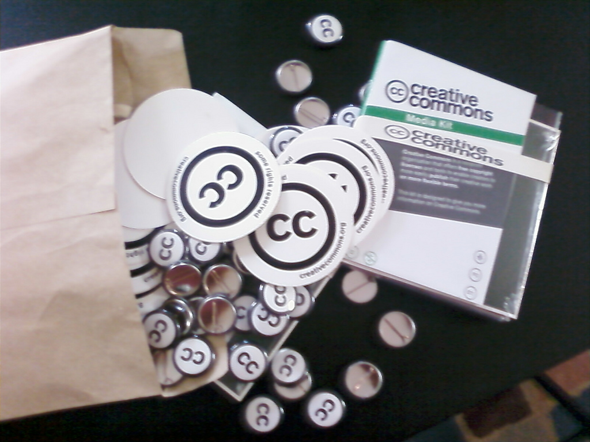

Creative Commons
& Education – Are we there yet?
Joscelyn Upendran
9 June 2015
@joscelyn
This presentation is © Joscelyn Upendran 2015 & licensed with a CC BY licence http://creativecommons.org/licenses/by/3.0/ (provide attribution to:– http://www.twitter.com/Joscelyn) (3rd party © & CC licensed images as stated as per individual image)
‘Creative Commons Licences for Madagascar’ by Foko Madagascar CC BY NC SA http://www.flickr.com/photos/foko_madagascar/2865834995/sizes/l/

Slide 2
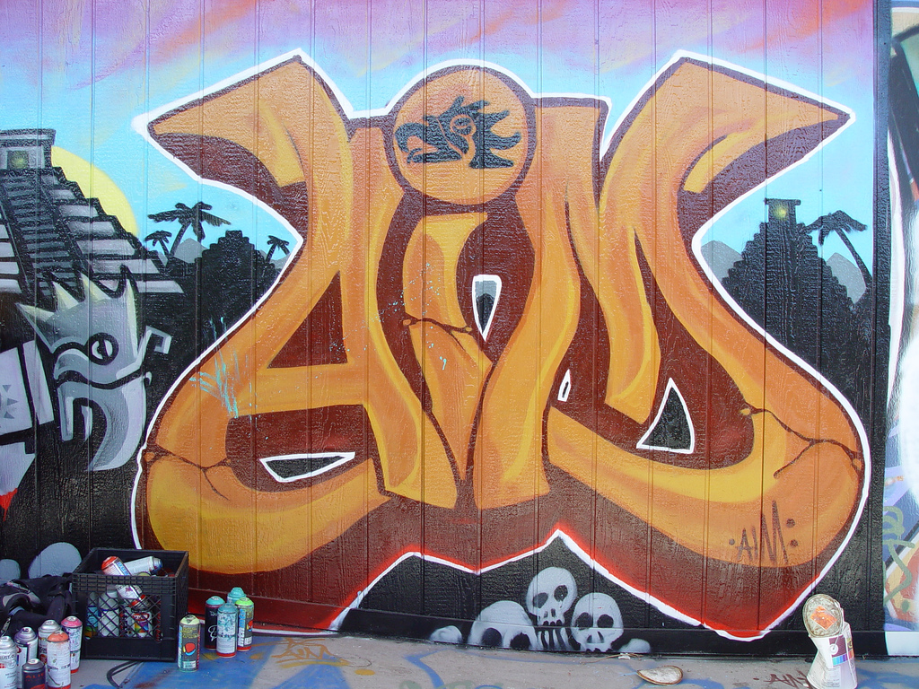
(brief) Overview of Creative Commons (CC) Licences
E.gs of Use in Education
Discuss advantages and main issues to consider re CC
    Getting Credit / Attribution
    Preserving Integrity of Work
    Third Party Content
    Permitting Commercial Use
4. Identify use in your professional role
‘Aim’ by Franco Folini CC BY SA http://www.flickr.com/photos/livenature/230664393/sizes/l/
Notes:
give a brief definition of creative commons licences, and illustrate the different types
provide examples of their use in education
identify advantages and points to consider in deciding whether to use them
identify at least one example of where you would use creative commons licences, in the context of your own professional role, or identify why it is not suitable in your particular case

Slide 3


  US Non Profit Organisation
  Free copyright licences to exercise copyright to suit the copyright holder
  13 years ago → now in 70+ jurisdictions
  Promotes easier sharing, innovation & creativity
    “All rights reserved” →
    “Some rights reserved”
What is it?
Book Stacks, The British Library (1978-97) by Colin St John Wilson CC BY SA (on Flickr) http://bit.ly/14a86bd

Slide 4
What CC is not ...
CC is not anti copyright
CC is not a copyright enforcement or legal services organisation
CC does not store or track your licensed content
‘The World Behind You’ by Foxspain CC BY http://www.flickr.com/photos/foxspain/3219577797/sizes/l/

Slide 5
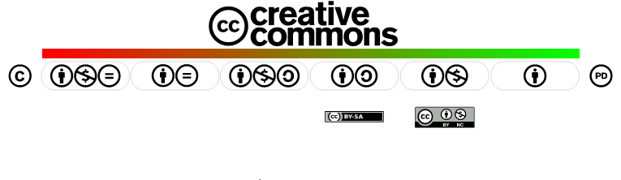




How do the CC licences work?
By - attribution
Sharealike
No Derivatives
Non-Commercial
Creative Commons CC BY : http://creativecommons.org/licenses/

Slide 6


CC0 – Public Domain Dedication & PDM
What is the difference between the two?
How do they work?
Notes:
CC0 – waiver by the copyright owner
PD marking content that is in the PD so that is can be discoverable – marking by anyone of content that is in the PD – “allows anyone to mark and tag a work that is free of known copyright restrictions worldwide, all in a way that clearly communicates that status to the public and allows it to be easily discoverable. should only be used to label a work that is already free of known copyright restrictions around the world,” PDM has a metadata-supported deed and is machine readable, allowing works properly tagged to be readily discovered over the Internet. Marking & labelling function only.

Slide 7

3 layers of licence
Creative Commons CC BY : http://creativecommons.org/licenses/

Slide 8
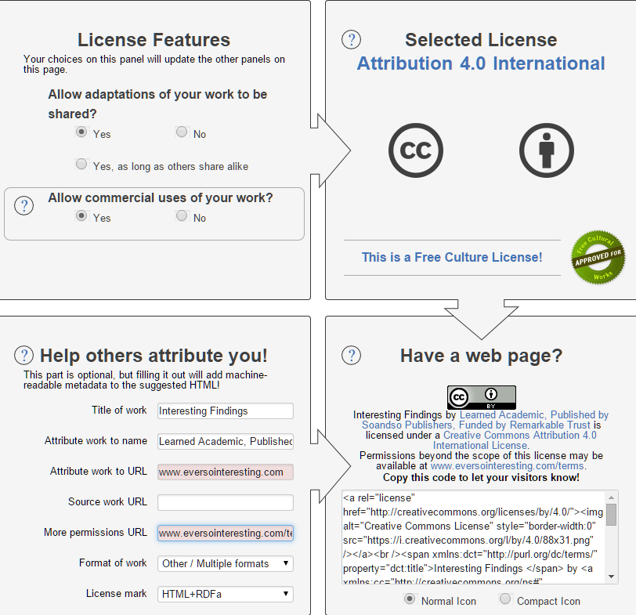
Choosing the licence you want
http://creativecommons.org/choose/
Creative Commons CC BY :http://creativecommons.org/choose/

Slide 9
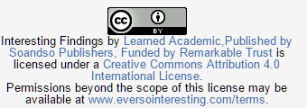
Marking your work & Attribution
Credit where it’s due, you can specify how, who
Creative Commons CC BY :http://creativecommons.org/choose/
Notes:
Norms & customs apply on top re citation
Failure to attribute is infringement

Slide 10












Slide 11

UK OER Project
£13.5 million over 3 phases April 2009-October 2012

Slide 12

US Federal education fund made available $2 billion to create OER resources in community colleges over 4 years (announced Jan 2011)
Conditions of the grant all OER content must be CC BY licensed

Slide 13
Search & Discovery
How/where do you discover CC licensed work?
NB onus on you to verify it is CC licence & what rights and obligations are

Slide 14
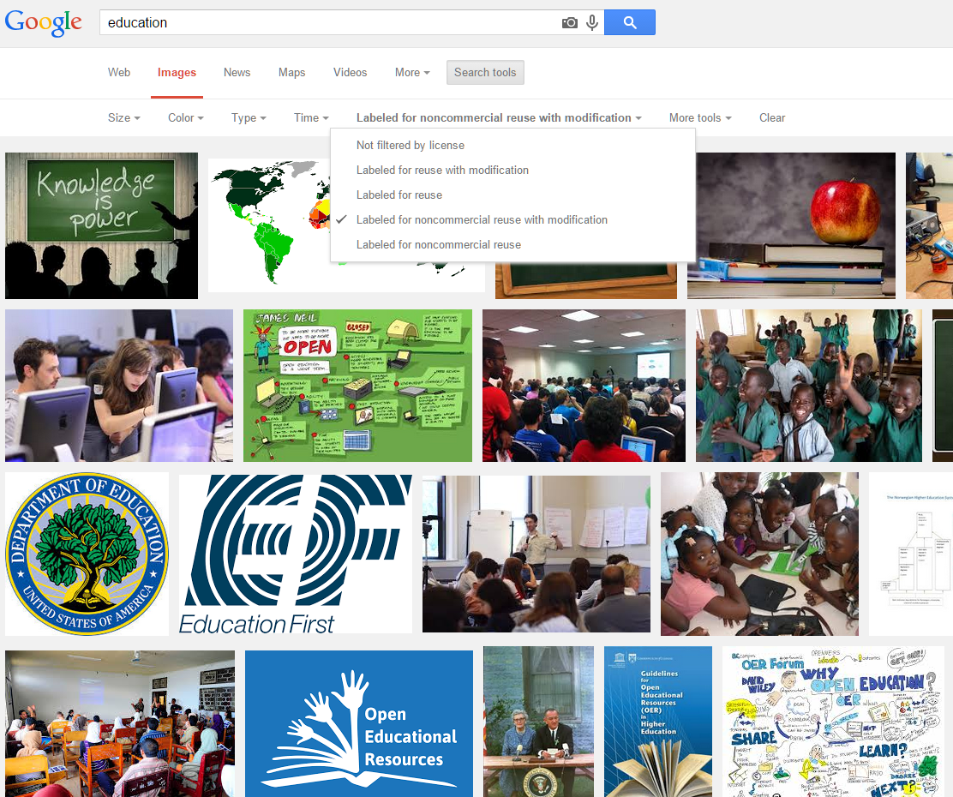

Slide 15
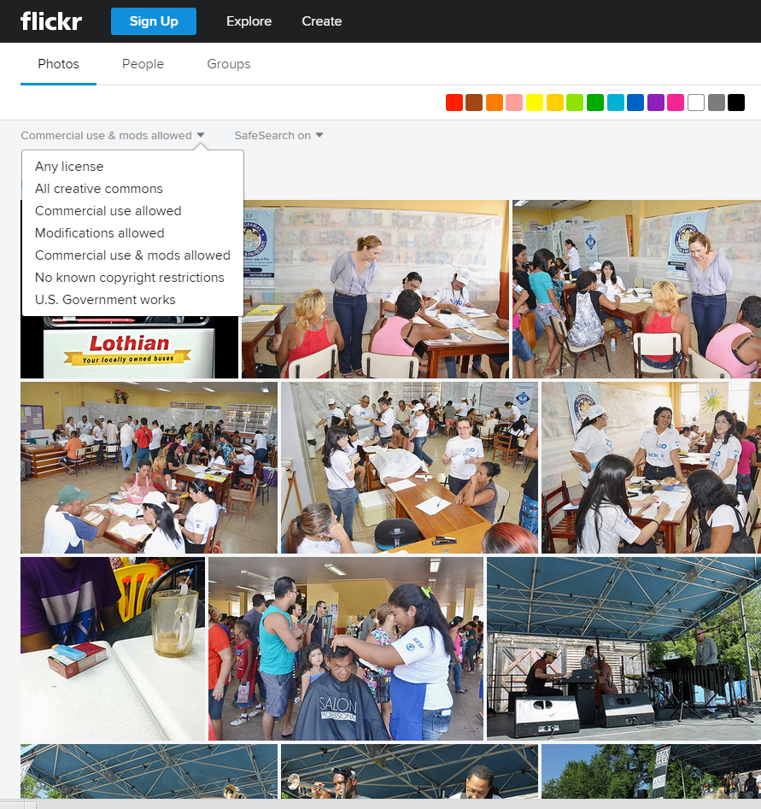

Slide 16

Integrity of work
‘passing off’
implying endorsement /affiliation
unfavourable remixing
CC licences specify ‘no endorsement’ ‘no sponsorship’
Can require link back to original work
UK OGL – government with similar concerns yet HMRC, ACAS, GovUK all use OGL
‘Image of books’ By shutterhacks CC BY http://bit.ly/19EWI9i (on Flickr)
Notes:
Open Government Licence bases on CC BY – site some of the e.g of content that is under CC BY esque licence so no fear HMRC, Business Link regulatory ACAS – employment law guides etc under OGL

Slide 17
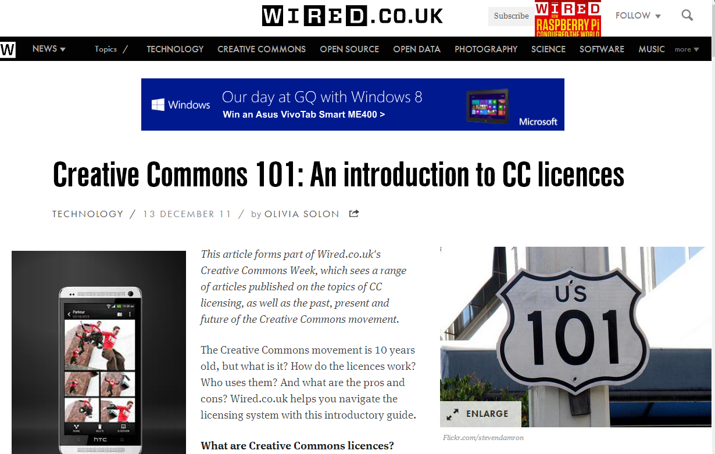
Third Party content
Use clear © notices and marking to make different works distinct
E.g. Wired, Guardian, BBC, when they use CC content, protect their own © by clear notices & marking
From http://www.wired.co.uk/news/archive/2011-12/13/creative-commons-101

Slide 18

Permitting commercial use
NC - Creates barriers to reuse
“primarily intended for or directed toward commercial advantage or private monetary compensation”
Can educators be prevented from reusing content that is licensed with a NC licence?
‘easy money’ By @Doug88888 CC BY NC SA http://bit.ly/11PIQnA (on Flickr)

Slide 19
Summary
CC offers Choice
CC licences are well established, globally recognised & legally robust © licences that enable frictionless sharing while requiring attribution
‘Creative Commons Licences for Madagascar’ by Foko Madagascar CC BY NC SA http://www.flickr.com/photos/foko_madagascar/2865834995/sizes/l/

Slide 20
Links re Qs
Legal Cases:
https://wiki.creativecommons.org/Case_Law
Open Education Policies:
https://wiki.creativecommons.org/OER_Policy_Registry
CC version 4.0 for Education
http://www.slideshare.net/janeatcc/v40-for-education-final

Slide 21
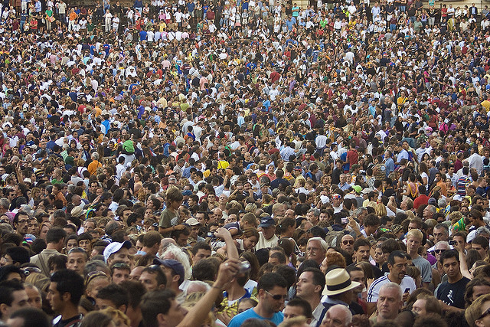

“Obscurity is a far greater threat to authors and creative artists than piracy.”
- Tim O’Reilly
Multitud// Crowd’ By PictFactroy CC BY http://www.flickr.com/photos/pictfactory/2796367140/

